Slide 1
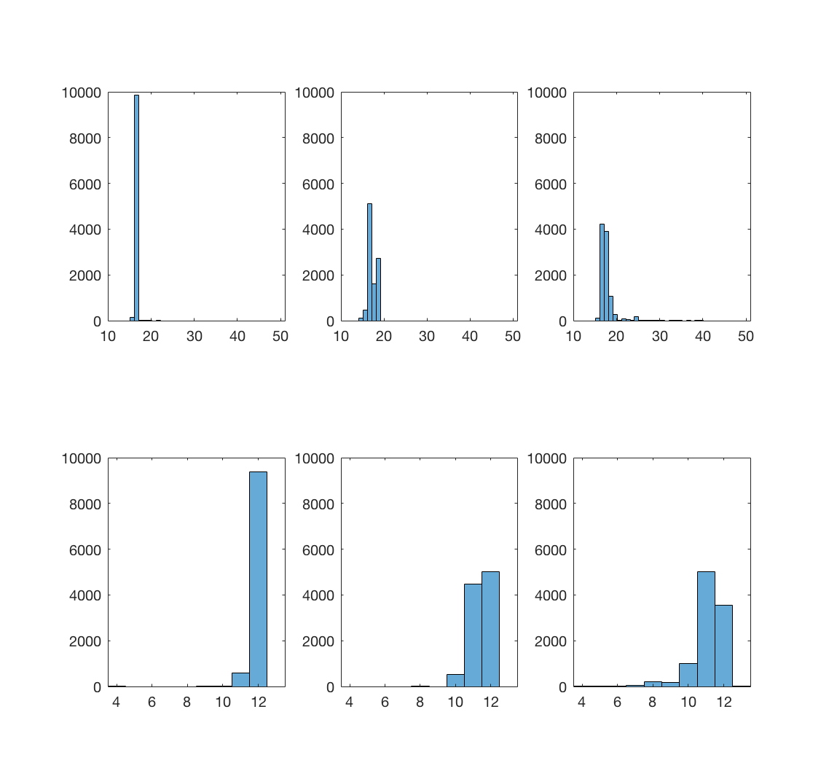
A
Chrome
Firefox
Safari
Frequency
Average Frame Rate
B
Chrome
Firefox
Safari
Frequency
Number of Frames

